Slide 1


FIELD INSPECTION
MONITORING & SUPERVISION
Mobile App & Online based Application to purposefully Capture and Analyze
the Inputs & Feedback of Field Inspections at District / Subdivision / Block levels
e-Gov Group
Finance Department, Government of West Bengal

Slide 2
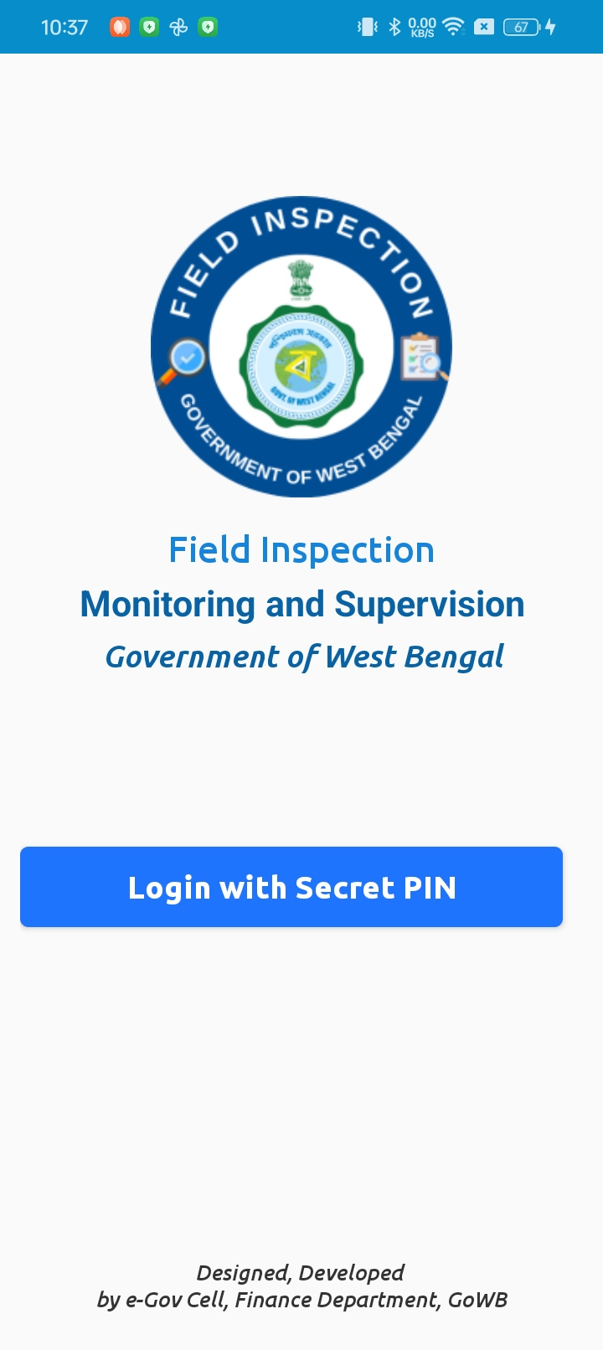
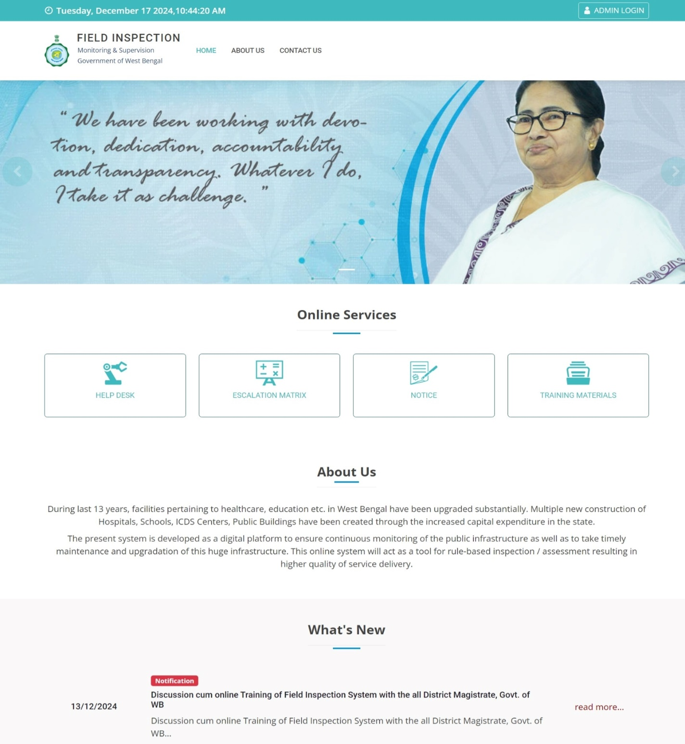
FIELD INSPECTION
MONITOING & SUPERVISION
Mobile App &
Online based Application

Slide 3

FIELD INSPECTION
MONITOING & SUPERVISION
Why this Mobile App & Online based System is launched?
What are the basic features of this system?
Who will be using/accessing this system?
What is the URL of this Online System? From where the Mobile App can be downloaded?
What are the Check Lists for successful implementation?
Who can Login?
How to get Secret Pin? What should I do if I forget Secret Pin to login the system?
How to Manage Users of different Roles at different hierarchical levels?
What to do in case any Official is Transferred / Retired?
How to collect Inspection Reports from lower-tier offices through Departmental channel?
Why I can not see the Category & Segment values for the Establishment I am visiting?
Why some official is unable to submit reports whereas others are facing no issues?
How to reach to Help Desk? What is the Issue Escalation Matrix?
We will try to clarify above during our today’s training-cum-discussion session.

Slide 4
FIELD INSPECTION
MONITOING & SUPERVISION
Why this Mobile App & Online based System is launched?
The State Government has undertaken construction of new infrastructure as well as infrastructure upgradation across the state with special focus in the sectors of healthcare, education, and women and child care. Multiple new construction of Hospitals, Schools, ICDS Centres, Public Buildings have been done through this increased capital expenditure in the state.
In order to ensure continuous monitoring of the public infrastructure as well as to take timely maintenance and upgradation of this huge infrastructure, an app based Digital Platform has been created. Standard Operating Procedure for the integrated system has been issued by the Finance Department (Audit Branch) vide Memo No. 4941-F(Y) dated 10th December 2024.
This Mobile App & Online based system will act as a tool for rule-based inspection / assessment of these infrastructure and related functions being carried out. It is envisioned that this digital platform shall also enable the reviewing authorities to act upon the information received from field level on real time basis and take appropriate action.

Slide 5
FIELD INSPECTION
MONITOING & SUPERVISION
What are the basic Technical Features of this system?
Mobile App based Inspection of Public Service Delivery Establishments Online Monitoring & Supervision at all hierarchical levels of Government OTP based Authentication Built on Responsive design to make the Online system accessible through Mobile/Tablets Automatic Geo-Tagging of Inspected Establishments Workflow based Processing & ATNs Role based Dashboard Provides scope to improve public service delivery

Slide 6
FIELD INSPECTION
MONITOING & SUPERVISION
Who can Login to the System?
Mobile Numbers need to be entered as Registered Users enabling access to Mobile App & Online System.
Mobile Numbers of HoDs & DMs are already registered as Department/District Admin.
Department/District Admin needs to register Mobile Nos. of Nodal Officer(s) .. 5 maximum
Nodal Officers in turn can register other officials under their purview
During 1st time login, system generated Secret Pin (OTP) will be sent to registered mobile number

Slide 7
FIELD INSPECTION
MONITOING & SUPERVISION (FIMS)
How to get Secret Pin? What should I do if I forget Secret Pin to login the system?
During first-time login in the portal by registered officials, after entering the mobile no. & Captcha value, Secret Pin will be sent through SMS from the system. There is no validity period of this Secret Pin, unless it is changed by concerned official. But, it is strongly advised to change the Secret Pin at regular intervals. In case, the Secret Pin is lost, the official may enter any 6 digits as Secret Pin during login, the system will prompt it as ‘Invalid Secret Pin’ and a ‘Forgot your Secret PIN?’ link will appear, clicking on it, new Secret Pin will be sent by the system through SMS to the official’s mobile.

Slide 8
FIELD INSPECTION
MONITOING & SUPERVISION
Who will be using/accessing this system?
    Officials of Administrative Departments, Districts, Sub-Divisions, Blocks/ULBs whose Mobile Nos. are registered by competent authorities will be able to access the system.
USERBASE for (a) Mobile App based Inspection and (b) Workflow based Follow-up (Forwarding to Upper / Lower Hierarchical levels) in Online System
BLOCK LEVEL
  BDO
    Mobile App aided Inspection
    Re-Inspection
    Review of Inspection Reports submitted to BDO
  Block level Officials
    Mobile App aided Inspection
    Re-Inspection

Slide 9
FIELD INSPECTION
MONITOING & SUPERVISION
SUBDIVISION LEVEL
  SDO
    Mobile App aided Inspection
    Re-Inspection
    Review of Inspection Reports submitted to SDO
  Subdivision level Officials tagged with Departments
    Mobile App aided Inspection
    Re-Inspection
    Review of Inspection Reports forwarded by BDOs

Slide 10
FIELD INSPECTION
MONITOING & SUPERVISION
DISTRICT LEVEL
  DM / ADMs
    Mobile App aided Inspection
    Re-Inspection
    Review of Inspection Reports submitted to DM / ADMs
  District level Officials tagged with Departments
    Mobile App aided Inspection
    Re-Inspection
    Review of Inspection Reports forwarded by Subdivisions

Slide 11
FIELD INSPECTION
MONITOING & SUPERVISION
ADMINISTRATIVE DEPARTMENT LEVEL
  HODs
    Mobile App aided Inspection
    Re-Inspection
    Review of Inspection Reports submitted to HODs
  Department level Officials
    Mobile App aided Inspection
    Re-Inspection
    Review of Inspection Reports forwarded by Districts

Slide 12
FIELD INSPECTION
MONITOING & SUPERVISION
What is the URL of this Online System? From where the Mobile App can be downloaded?
Online URL
https://ds.wb.gov.in/INSWEB
OR
In State Finance Portal (https://finance.wb.gov.in), there is a link button under Services at Right Hand Side of landing page
Mobile App download link from Google Play Store https://play.google.com/store/apps/details?id=com.nic.ins
OR
Search in Google Play Store Field Inspection, you will see Field Inspection App (WBMDTCL) ..this app is uploaded from WBMDTCL Account

Slide 13
FIELD INSPECTION
MONITOING & SUPERVISION (FIMS)
What are the Check Lists for successful implementation?
CHECKLIST
Followings may be ensured
Admin/Nodal Officer of Departments need to enter the Sector & Category of Public Service Delivery Establishments under their purview, otherwise those will not appear in the drop-down list boxes in the Field level Inspection Mobile App Admin/Nodal Officers of Districts need to ensure that all Sub-Divisions are there under that District. Similarly, Admin/Nodal Officers Sub-Divisions/Blocks/ULBs need to ensure that all lower-tier layers are there & those are correctly mapped. Admin/Nodal Officer of all hierarchical levels need to enter the Mobile Number(s) of Admin of their lower tier (s) Admin/Nodal Officer of all hierarchical levels need to enter the Mobile Number(s) of Officials (at that level) earmarked for field level inspection During field level inspections, Officials need to ensure that the GPS is ON in their Mobile devices. Otherwise, he/she will face technical issue while uploading photographs.

Slide 14
FIELD INSPECTION
MONITOING & SUPERVISION (FIMS)
How to reach to Help Desk? What is the Issue Escalation Matrix?
FIMS Implementation Issue - Escalation Matrix
Districts / Sub-Divisions / Blocks / ULBs
Following route needs to be followed for resolution of issues
For Administrative Clarifications/Issues, Officials need to contact with the Nodal Officer (FIMS) of concerned District/Sub-division/Block/ULB through Email/Contact Phone Number If needed, concerned Nodal Officer in turn may get in touch with higher authorities
For Training/Technical Clarifications/Issues, Officials need to contact with the DIO/ADIO, NIC of concerned District through Email/Contact Phone Number If needed, DIO/ADIO in turn may get in touch with the Central Help Desk through Email/Contact Phone Number Contact details of Nodal Officers (FIMS) / DIOs / ADIOs may be circulated by District Authorities for smooth execution of FIMS

Slide 15
FIELD INSPECTION
MONITOING & SUPERVISION (FIMS)
How to reach to Help Desk? What is the Issue Escalation Matrix?
FIMS Implementation Issue - Escalation Matrix
Administrative Departments
Following route needs to be followed for resolution of issues
For Administrative Clarifications/Issues, Officials need to contact with the Nodal Officer (FIMS) of concerned Department If needed, concerned Nodal Officer in turn may get in touch with higher authorities
For Training/Technical Clarifications/Issues, Officials need to contact with the SSPs (trained on FIMS) posted in the concerned department If needed, the SSPs in turn may get in touch with the Central Help Desk through Email/Contact Phone Number Contact details of Nodal Officers (FIMS) / SSPs may be circulated by Departments for smooth execution of FIMS

Slide 16
FIELD INSPECTION
MONITOING & SUPERVISION (FIMS)
How to reach to Help Desk? What is the Issue Escalation Matrix?
For resolution of Technical Clarifications/Issues, Officials of Districts/Sub-Divisions/Blocks need to connect with DIO/ADIO NIC of concerned district (https://wb.nic.in/district-centres). Officials of Departments need to connect with SSPs posted in the concerned Department. If needed, DIO/ADIO from Districts and SSPs from Departments may get in touch with the Central Help Desk through Email/Contact Phone Number: - Email: egov.fin@gmail.com Contact Phone: 8967435526, 6297044450, 9564731941, 9475191393

Slide 17
FIELD INSPECTION
MONITOING & SUPERVISION (FIMS)
Why I am not getting desired MIS/Reports needed for better Monitoring?
As per directions of the Hon’ble Chief Minister in the review meeting held on 9th December 2024 and in order to ensure continuous monitoring of the public infrastructure as well as to take timely maintenance and upgradation of this huge infrastructure, this app based Digital Platform has been created for Field Inspection – Monitoring & Supervision.
This system is developed & made operational within Shortest Possible Time. Various MIS will be subsequently augmented at all hierarchical levels for better monitoring. Suggestions for incorporations of MIS may be sent through Department/District Nodal Officer to egov.fin@gmail.com

Slide 18
FIELD INSPECTION
MONITOING & SUPERVISION (FIMS)
How to Manage Users of different Roles at different hierarchical levels?
What to do in case any Official is Transferred / Retired?
How to collect Inspection Reports from lower-tier offices through Departmental channel?
Why I can not see the Category & Segment values for the Establishment I am visiting?
Why some official is unable to submit reports whereas others are facing no issues?
  Detailed Demonstration will be given now

